Slide 1


Artificial Intelligence and Its Applications
Introduced by
Hassan Zain-Elaabideen Khalifa

Slide 2
Outlines:
Introduction
Branches of AI
Applications of Artificial Intelligence (AI)
Difference between machine learning and programing
Neural networks and Deep learning
How do we benefit from artificial intelligence?
How do we learn AI?

Slide 3
Introduction
Artificial intelligence (AI) is the ability of machines or computer programs to perform tasks that normally require human intelligence, such as reasoning, learning, decision making, and problem solving.
AI has many applications in various fields and domains, such as healthcare, finance, education, entertainment, and science.

Slide 4
Branches of AI:
Machine Learning:
is the technique that gives computers the potential to learn without being programmed
Neural Network.
Robotics.
Expert Systems.
Fuzzy Logic.

Slide 5
Applications of AI:
AI has many applications; here are some of them:
Spam filter.
Facebook (image recognition).
Search engine(searching).
Recommendation(amazon).
Voice-to-text.
Solving differential equations, which are mathematical equations that describe how a quantity changes with respect to one or more variables. Differential equations are widely used to model physical phenomena, such as fluid dynamics, heat transfer, biomechanics, elasticity, electromagnetism, and quantum mechanics..

Slide 6
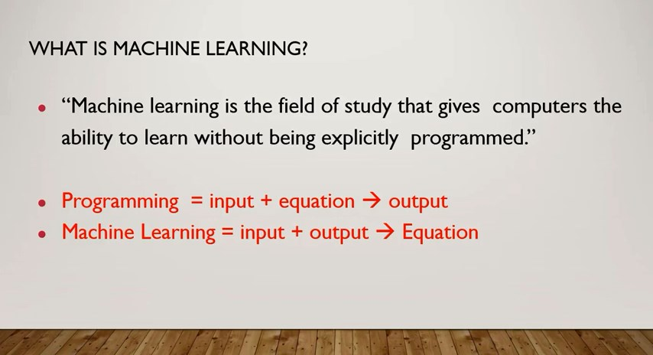
Difference between machine learning and programming:

Slide 7
Neural networks and Deep learning:
Neural networks are computational models that consist of interconnected units called neurons, which can learn from data and perform nonlinear transformations.
Deep learning is a branch of machine learning that uses multiple layers of neural networks to learn complex patterns and features from large amounts of data.

Slide 8
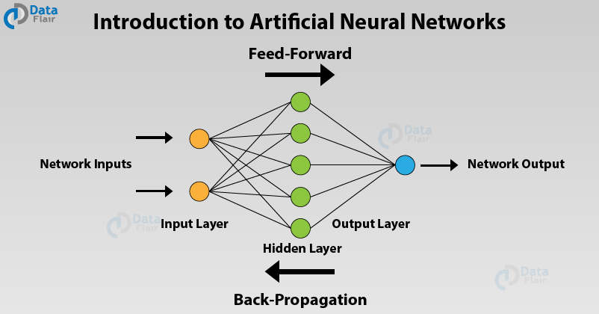

Slide 9
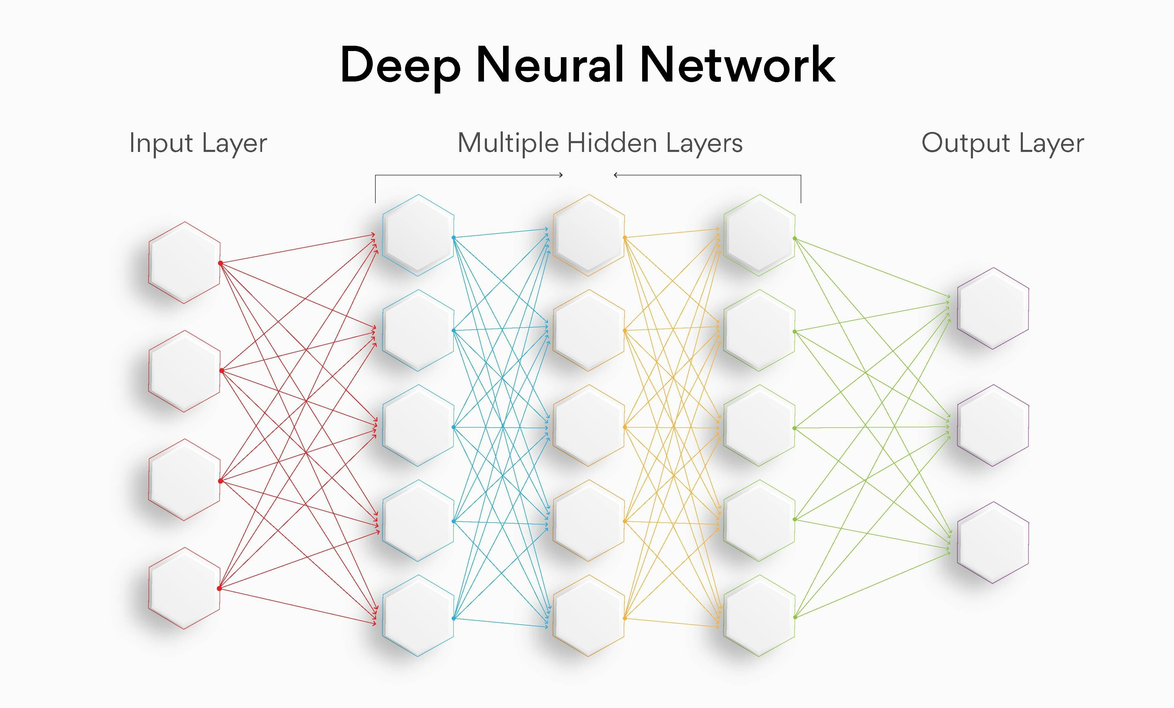

Slide 10
How do we benefit from artificial intelligence?

Slide 11
Applications of AI in mathematics?

Slide 12
How do we learn AI?

Slide 13
Applications of mathematics in AI?

Slide 14
Thank you for your time

